Slide 1
Lecture 13: Placement – III
Tsung-Wei (TW) Huang
Department of Electrical and Computer Engineering
University of Utah, Salt Lake City, UT

Slide 2
Recap: Analytical Placer
Write an equation whose minimum is the placement
If you have a million gates, need a million (xi, yi) values as result
Formulate an appropriate cost function for all the gate-level (xi, yi): F( x₁, x₂, … x_{1M}, y₁, y₂, … y_{1M})
Solve analytically for X*=(x₁, x₂, … x_{1M}), Y*=(y₁, y₂, … y_{1M}) to minimize F( )
The resulting values of X*, Y* give you the placement of all 1M gates
This sounds sort of crazy… but it works great
All modern placers for big ASICs and SOCs are “analytical”
Big trick is write the wirelength in mathematically “friendly” form we can optimize

Slide 3
Recap: Quadratic Wirelength Model
We optimize squared length of “distance” line between points: (x1-x2)² + (y1-y2)²
A “2-point net”
Quadratic wirelength
=(3-1)² + (4-1)²
=13
y=5
4
3
2
1
0
For k-point net, we use the clique model (complete graph for each net)
x= 0 1 2 3 4

Slide 4
Recap: Quadratic Placement Formulation
(0, 1)
(1,1)
1
0 1 10 0 0
1 0 1 1 1
10 1 0 1 0
0 1 1 0 1
0 1 0 1 0
21 -1 -10 0 0
-1 4 -1 -1 -1
-10 -1 13 -1 0
0 -1 -1 4 -1
0 -1 0 -1 3
3
C =
A =
4
Weight=10
5
2
Weight=10
b_{x} = 0
0
1
1
0.5
b_{y} = 10
0
0
1
0
(1,0)
(0.5,0)
All wire weights = 1 except two highlighted:
gate1 to pad and gate1 to gate2

Slide 5
Recap: Quadratic Placement Result
Placement → Solving a linear system

Slide 6
Summary
We have discussed a new analytical placement algorithm
We have discussed the quadratic wirelength model
Construct the matrix A (NxN) for a placement problem of N gates
Construct the vector b_{x} and the vector b_{y}
Formulate the placement problem into a linear system
Solve the linear system and get the gate locations
We will dive into the quadratic placement problem next

Slide 7
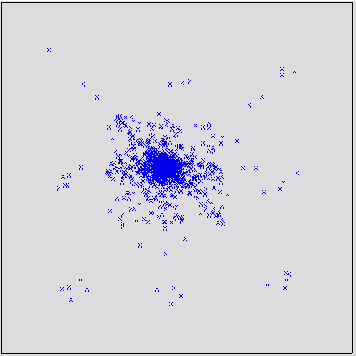
How does Quadratic Placement Look?
Like the right figure:
Small IBM ASIC, few thousand gates
All lumped together to give the minimum wirelength
New problem:
Quadratic model minimizes wirelength for big netlists, in a numerical way
But ignores that gates have physical size, cannot be on top of each other
Now, we have to fix this…
Our solution: recursive partitioning

Slide 8
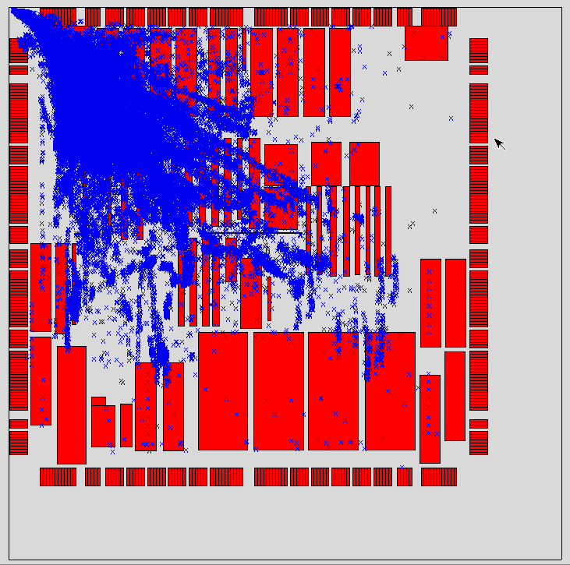
A Bigger Industrial Example
This benchmark is from IBM
210,904 gates (blue)
543 fixed blocks (red) –like SRAMS
Image shows where gates “want” to go if we model blocks like “big pads”
This is a quadratic placement of gates
Additional problems: gates need to go between these blocks!
Why we are showing this?
Example of how badly imbalanced the quadratic placement can be

Slide 9
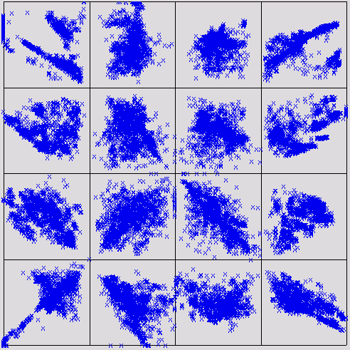
Recursive Partitioning
1st quadratic place (QP) solve
Partition chip into left / right. Select which gates on each side.
Solve 2 new, smaller QP tasks
Repeat. Partition each side top/bottom.
Solve 4 new smaller QP solves
Just keep going

Slide 10
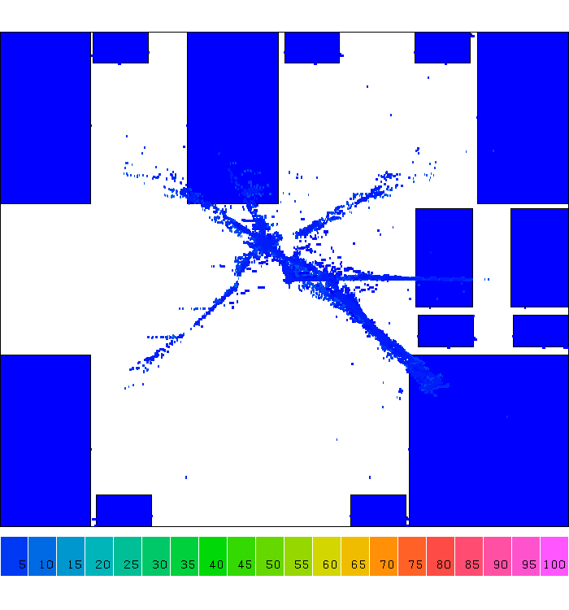
Example: Partition-based Placement
Notes:
Let's take a look at one step of computer design, placement. A placement is a step that tries to find the location of each gate, you know Or gate, NAND gate, NOT gate, and other gates, in a chip area. And we have billions of gate to place in a finger size chip.
Computer design tools don't do this. They do this in divide and conquer. (explain)

Slide 11
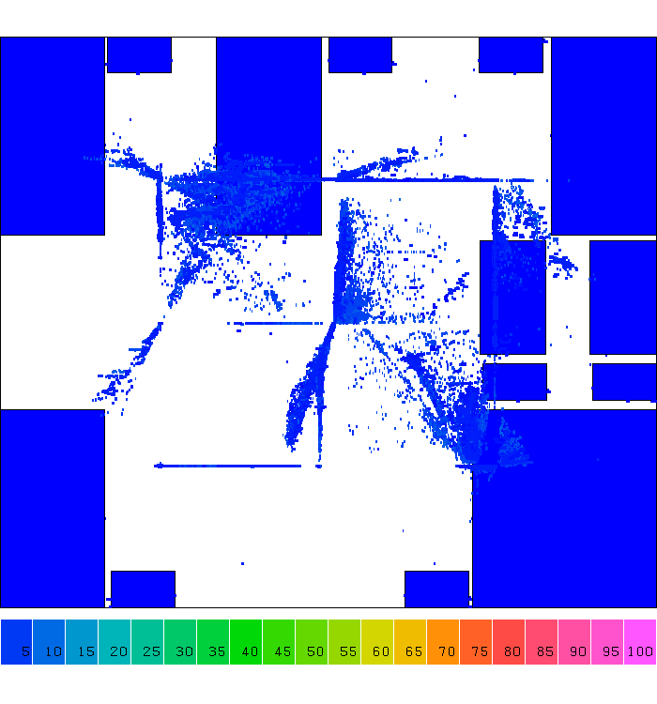
Example: Partition-based Placement

Slide 12
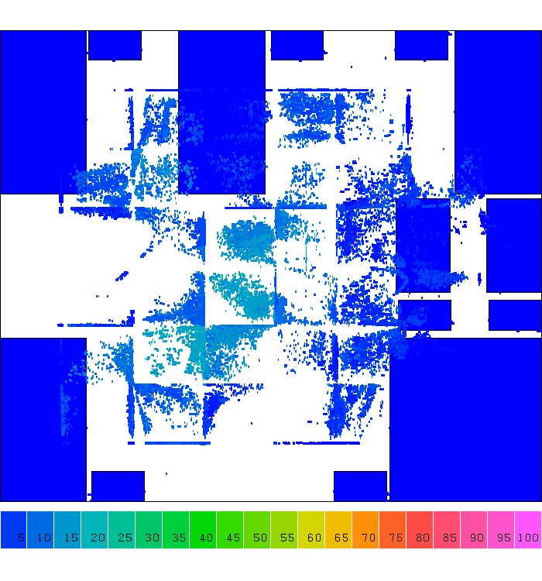
Example: Partition-based Placement

Slide 13
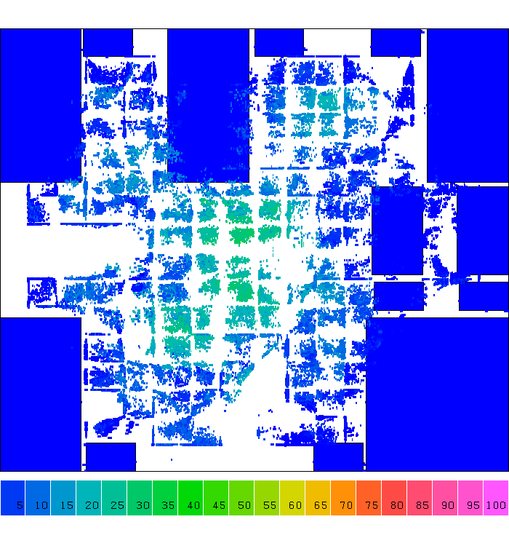
Example: Partition-based Placement

Slide 14
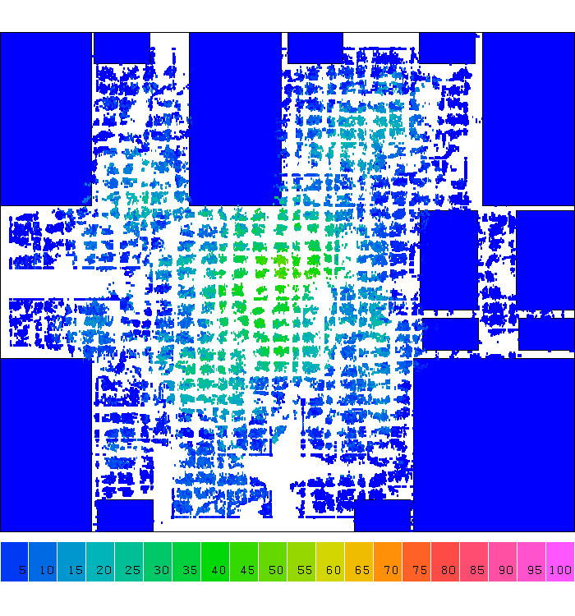
Example: Partition-based Placement

Slide 15
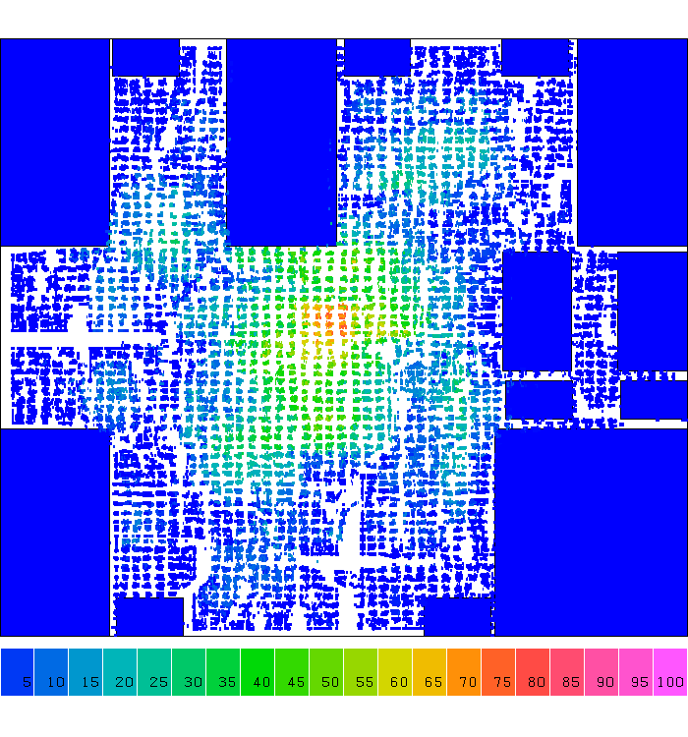
Example: Partition-based Placement

Slide 16
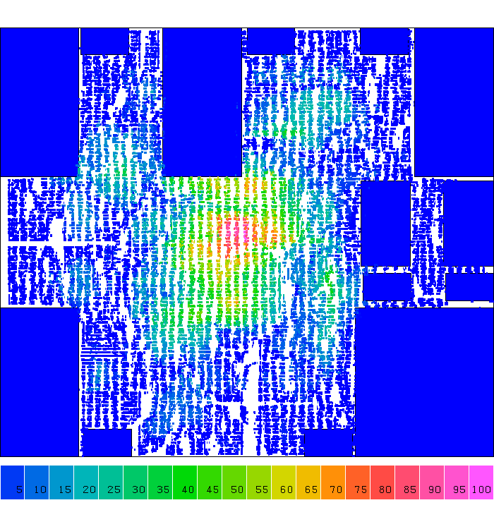
Example: Partition-based Placement

Slide 17
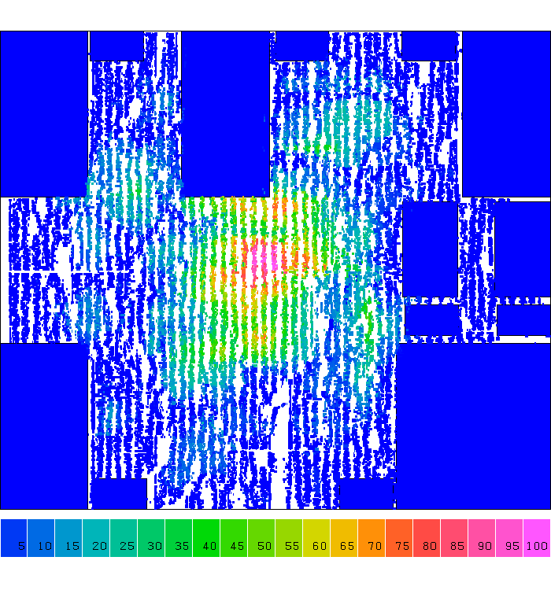
Example: Partition-based Placement
Notes:
So, from iteration to iteration you can clearly see cells are placed very regularly, right, Cells are spreading along the 2D grid partition. We partition the large chip care into smaller grids and place cells in those small grids. Solving the smaller grid problem is definitely more efficiently than directly handling the original problem.

Slide 18
Quadratic Legalization: Basic Idea
Partition
How do we divide the chip into new, smaller placement tasks?
Assignment
Which gates should go into each new, smaller region?
Containment
Formulate new linear system matrix solves so gates stay in new regions, with short wirelength
Discuss one early strategy from a classical paper
Ren Song Tsay, Ernest Kuh, Chi Ping Hsu, “PROUD: A Sea-Of-gates Placement Algorithm,” IEEE Design & Test of Computers, Dec 1988.

Slide 19
Recursive Partition
After 1st quadratic placement (QP), divide chip area exactly in half, vertically (horizontal is ok too)
We want half the gates on each side

Slide 20
Recursive Partitioning: How to Assign?
What if QP does not spread gates evenly between halves?
How do we know which gates to put left vs right if this is initial QP?
We partition region at exact center. How do we reformulate a new QP to re-do the gates on each side?

Slide 21
Recursive Partitioning: How to Assign?
Sort placed gates on X coordinate, then Y (for horizontal cut – sort on Y first, then X); If N total gates, then first N/2 in sorted list go on left; others on right
Sorted on X coordinate, these are left-most N/2 of N gates
This sorting assigns which gates go left, and go right

Slide 22
Recursive Partitioning: How to Assign?
R
R
Focus on the gates inside this shaded region R on the left side of the cut.
New big questions:
(1) How do we keep the gates assigned to left side actually in the left side?
(2) How do we model wires that connect to gates/pads on right? Can’t ignore these!

Slide 23
Recursive Partitioning: How to Contain?
Idea: Pseudo-pads
Every gate & pad not inside region R is modeled as a pad on boundary of R
Propagate these outside gates using their current (x,y) location to nearest point on R;
For this example, we take the y coordinate, and put pad on center of cut line x
R
R
Solution: model gates/pads on right as “fake” pads on left.
Resulting new QP problem for gates in left region

Slide 24
Why this Works?
Cannot ignore gates outside region we are re-placing
Want gates inside to feel pull from wires to gates outside region
Pseudo-pads do this for us
Pseudo-pads guarantee all gates re-locate inside region
Think of wires as ‘springs’ that each pull gates toward other gates or pads
If pads (real & pseudo) are on edges of region – QP keeps gates inside

Slide 25
Example
a
a
a
1
2
1
placed
1
5
b
5
5
b
b
4
2
4
2
3
4
3
3
c
c
c
1. Initial netlist
5 gates (1,2,3,4,5)
8 wires
3 pads (a,b,c)
2. Initial QP
3. First partition
Sort on X:
Gate order 1 5 4 3 2
Pick: 1 5 4 on left

Slide 26
Example (cont’d)
Note: do not propagate pad b, since no wires on left connect to it
placed
a
a
a
1
1
1
5
5
5
b
4
2
2
4
2
4
2
3
3
3
3
c
c
c
4. Propagate gates/pads
Right-side gates: 2,3
Right-side pads: b
Push to cut, using y coordinates
5. 2nd QP input
This is set up for this new smaller placement
6. 2nd QP solved
New placement

Slide 27
Example (cont’d)
a
placed
a
placed
placed
1
1
1
1
1
5
2
2
2
5
5
5
5
b
b
b
b
2
4
4
4
3
4
3
4
3
3
c
c
c
c
c
7. Left side placed.
Now, re-place right-side gates.
8. Propagate gates/pads
This is set up for next, new smaller placement
9. 3nd QP input
This is set up for this new smaller placement
10. 3nd QP solve

Slide 28
Example (cont’d)
Note: do not propagate pad b, no wires to 1,5
Note: gates 2,3 propagate to corner of new region: closest point
a
placed
placed
a
a
placed
1
1
1
5
5
b
5
b
b
2
2
4
2,3
2
4
4
4
3
3
3
c
c
c
Repeat: Horizontal
partition on left
Focus on top. Sort gates on Y
Assign gates 1,5 to region.
Propagate gates & pads
Note: gate 4 propagates up to bottom of new region

Slide 29
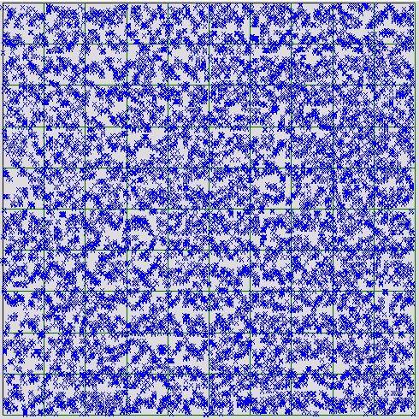
Keep Repeating this Recursion
Keep recursively partitioning…
Usually, you continue until you have a “small” number of gates in each region
Small >> 1 typically. 10-100 for example
Get a good, “global” placement, but not a “final” placement
a
placed
placed
1
2
5
b
4
3
placed
placed
c
Continue…

Slide 30
Final Placement Step: Legalization
Still need to force gates in precise rows for final result
QP methods cannot force individual gates into standard cell rows, without overlaps
Solution step is called: Legalization
Many different algorithms. One easy way to do this is by annealing!
Do local improvement based on swaps of nearby gates
To anneal, set T=HOT to be very small (cold), so don’t disrupt QP result

Slide 31
Summary
We have discussed problems of plain quadratic placement
Gates are easily lumped together to minimize wirelength
We have discussed a solution: partition-based placement
Partition the placement region iteratively
Introduce auxiliary pads between partition boundaries
We have discussed legalization
Remove all overlaps among gates
Improve wirelength in a local region (e.g., rows)

